Slide 1
Project Quack
Presented by
The Bestagons

Slide 2
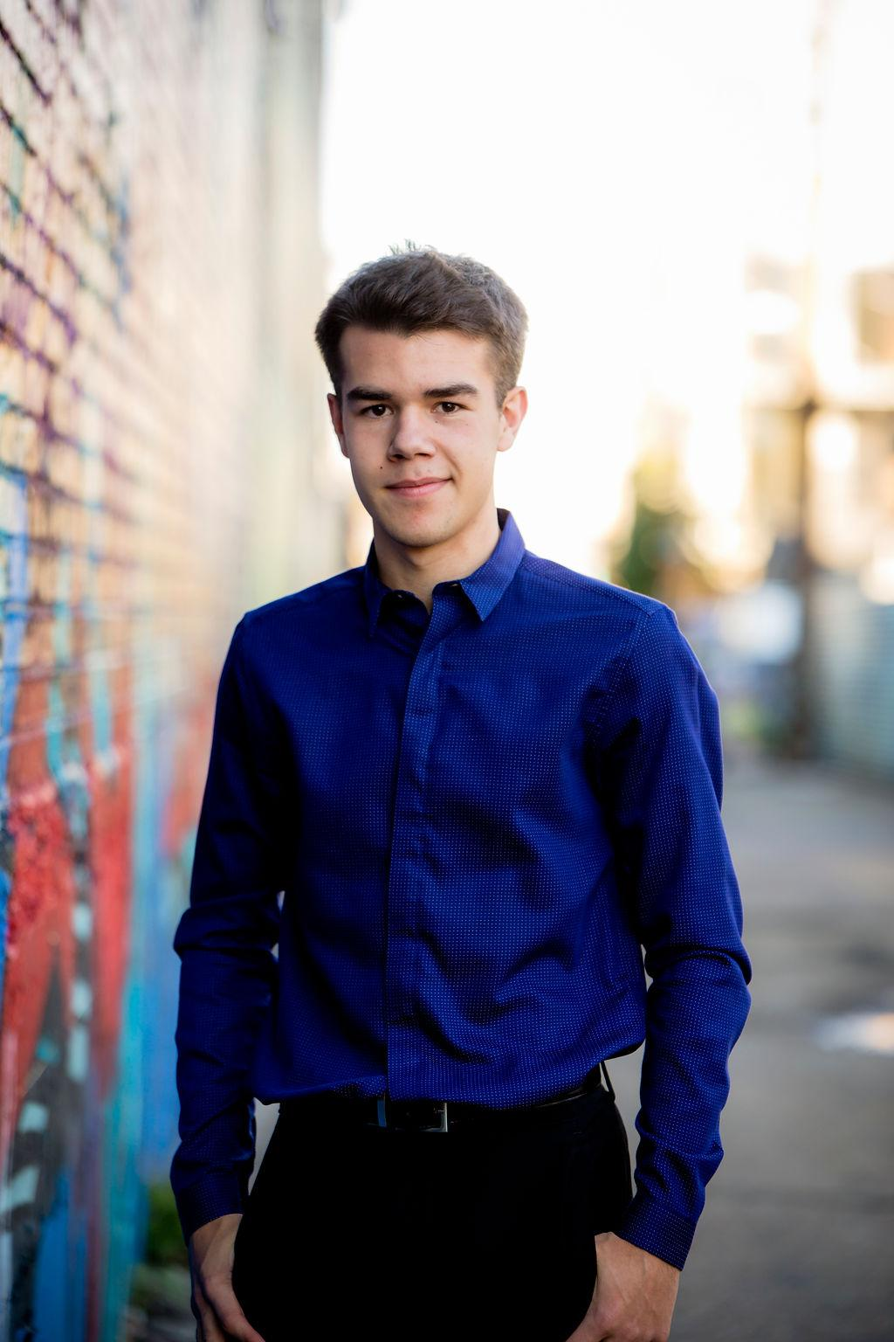


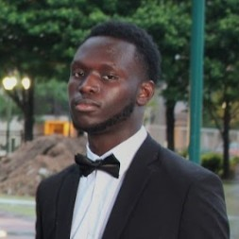
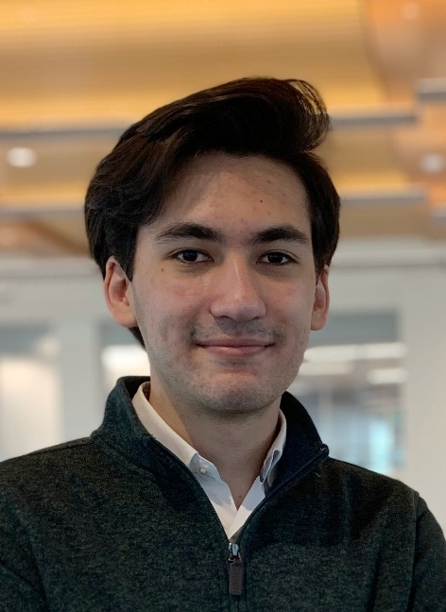
OUR TEAM
Ore Adenikinju
Miles Robertson
Rafael Piloto
Team member
Product Owner
Scrum Master

Slide 3
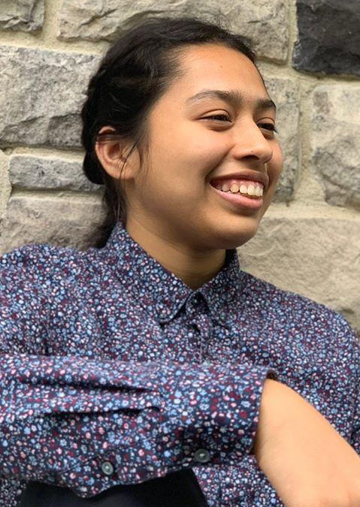
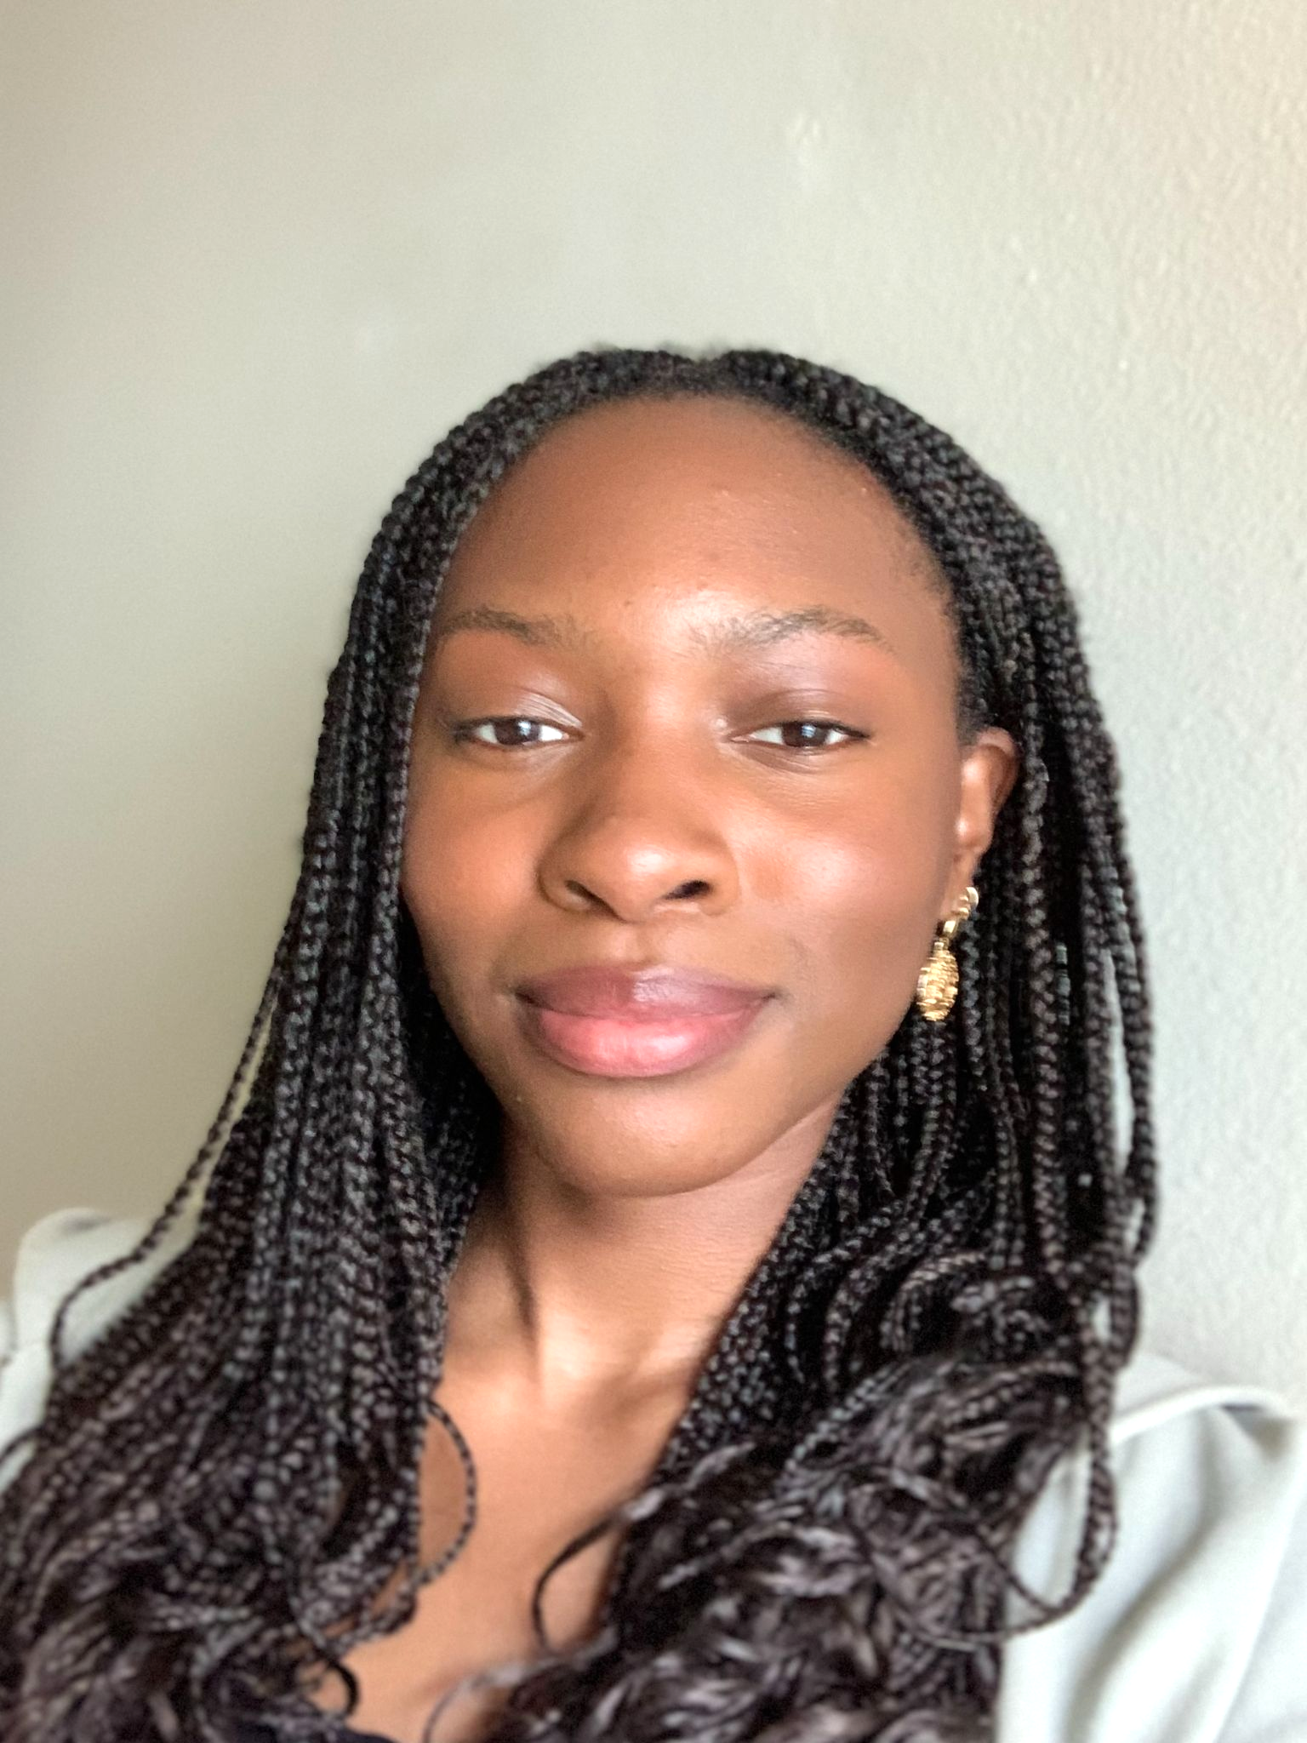
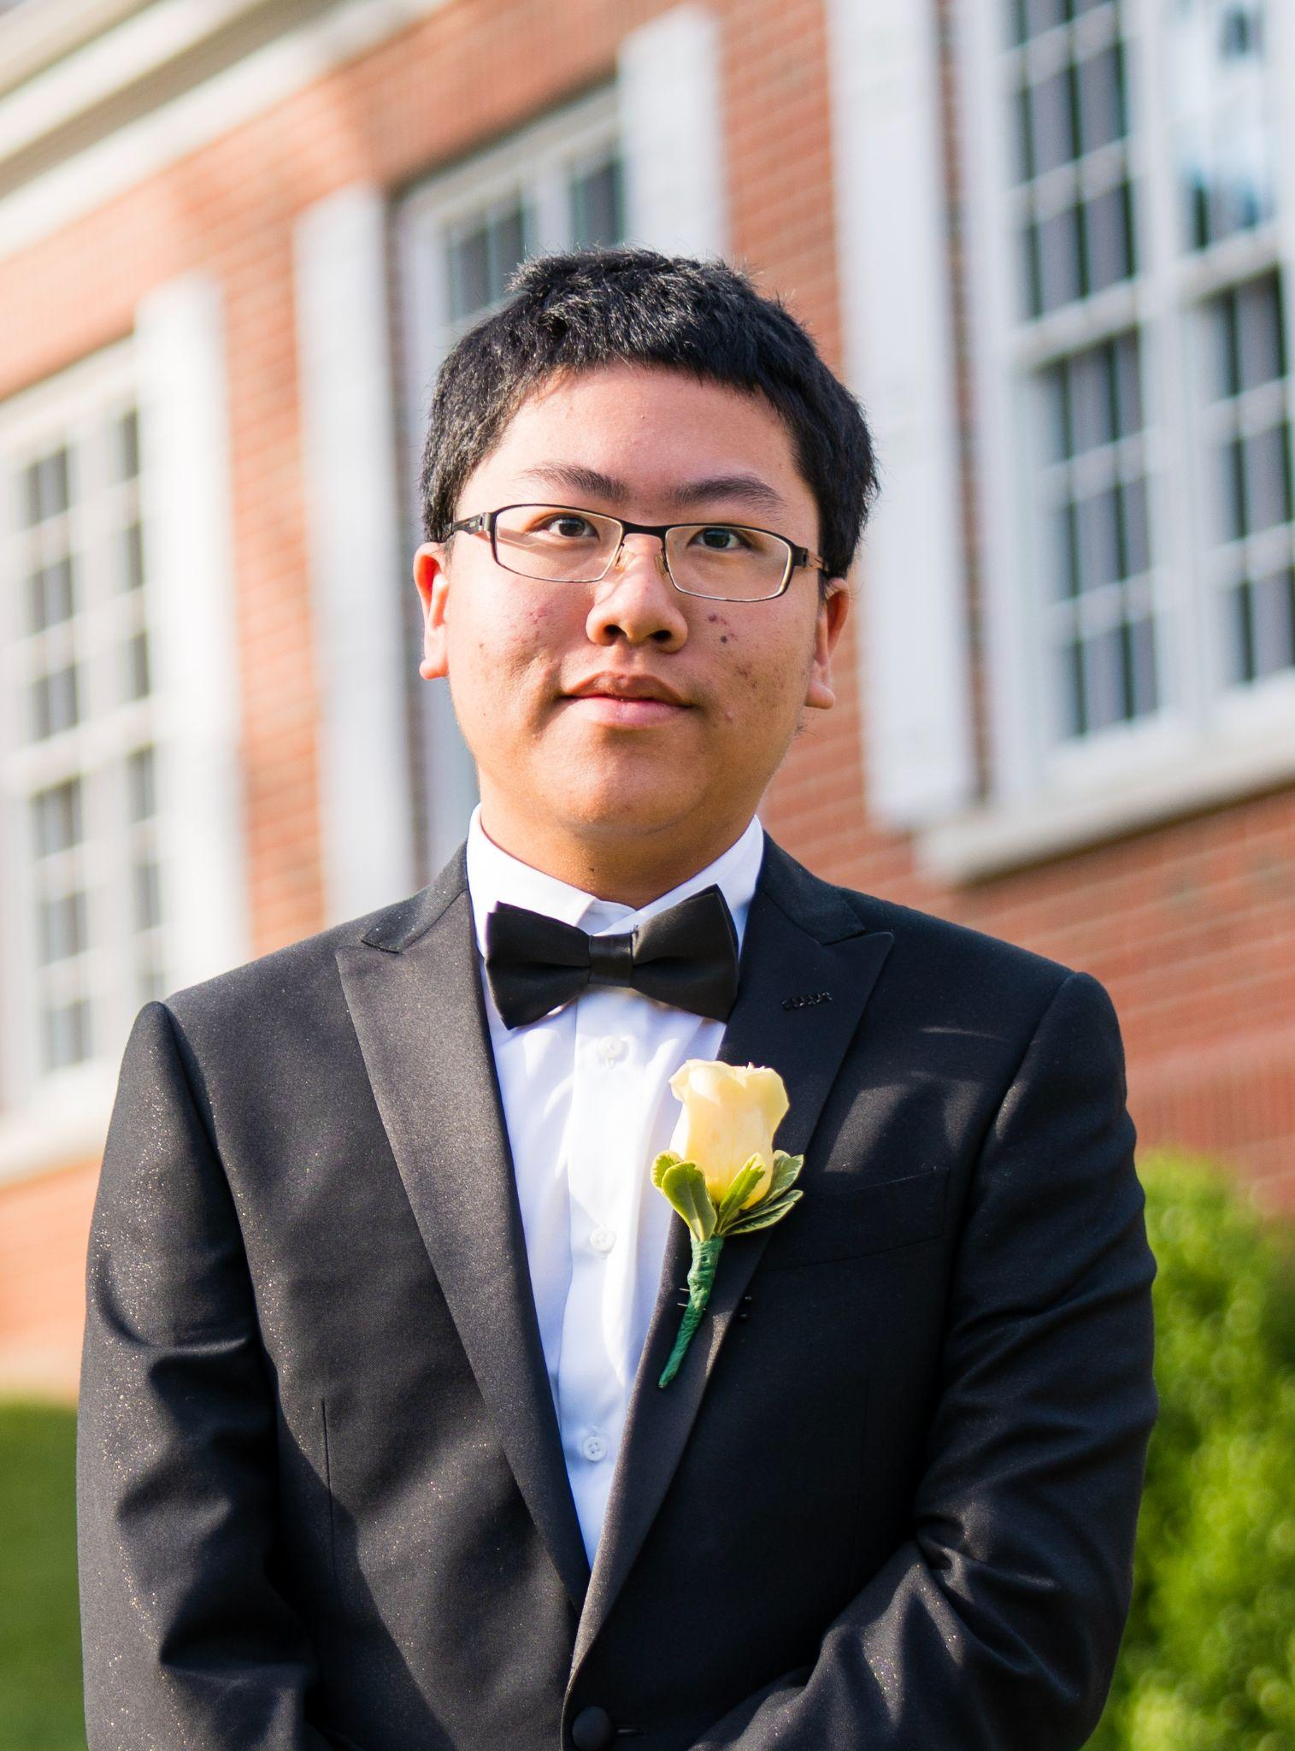
OUR TEAM
Mimi Olayeye
Brenda Cano
David Wei
Team Member
Team Member
Team member

Slide 4
MISSION STATEMENT
Bestagons are a 6-person team dedicated to developing the experience and skills necessary for a common project to build up their resumes. Centered around their shared experience as Emory students, they hope to add value to some of the lives of their community through their work.

Slide 5
VISION STATEMENT
The Quack Project on every Emory student’s phone, organizing the calendars of users & eliminating all frustrations with on-campus dining.

Slide 6
PROBLEM VS OUR SOLUTION (elevator pitch)
PROBLEM
SOLUTION
Returning from a pandemic, Emory University hasn’t quite figured out all the best systems yet. Coordinating a consistent student experience of classes and dining has yet to be achieved. Dining options are in flux and unclear, similar to student organizations that are learning how and when to plan in-person events again.
An app that increases the quality of life of Emory students both by finding free time in your calendar to suggest events/activities to integrate into your schedule (i.e. when to study, eat, etc.) and by adding value to the experience of getting food at DCT (food locations, capacity, etc.).

Slide 7
01
BUSINESS VALUE

Slide 8
Business Value
1
2
3
Increase DCT Knowledge
Create heuristic measurements
Optimize Your Schedule
Integrate with Schedulefly
Reduce Planning Time
Find time to dine with friends
Notes:
Miles

Slide 9
02
CUSTOMERS/USERS

Slide 10
University students who are on meal plans

Slide 11
03
METRICS

Slide 12
Metrics
Positive feedback from audience
Working software every sprint
Class Grade
Completion of assigned tasks
Member’s participation at Demo
Did everyone talk at demo?

Slide 13
04
MILESTONES

Slide 14
MILESTONES
Have an open-able app on Android
Have an open-able app on iOS
First test passes
First-time pair coding
Something to Demo every week
Have 90% done before December
Have 80% done before Thanksgiving
Setup organizational structures
Github, etc

Slide 15
05
RESOURCES

Slide 16
RESOURCES
Hatchery Grant
APIs
Databases and documentation
Human Resources
Six students working about 2-3 hours per week
Professor Fossati for additional support
Notes:
Apply for hatchery grant
6 students working 2-3 hours per week

Slide 17
06
RISKS

Slide 18
Risks
COVID
COMPLEXITY
Our project relies on in-person interaction
We have a LOT of ideas!
HARDWARE ISSUES
OTHER COMMITMENTS
Some of our group members have the M1 Chip
Limited time may affect our velocity
LOSING A KEY DEVELOPER
EXPENSES
Delegating tasks can be difficult if we are not involved
Resources we plan on using may not be free

Slide 19
07
TRADE-OFFS

Slide 20
Trade Offs
 | FIXED | FIRM | FLEXIBLE | FLUID
SCOPE |  | X
DATES | X
RESOURCES |  |  |  | X
QUALITY |  |  | X

Slide 21
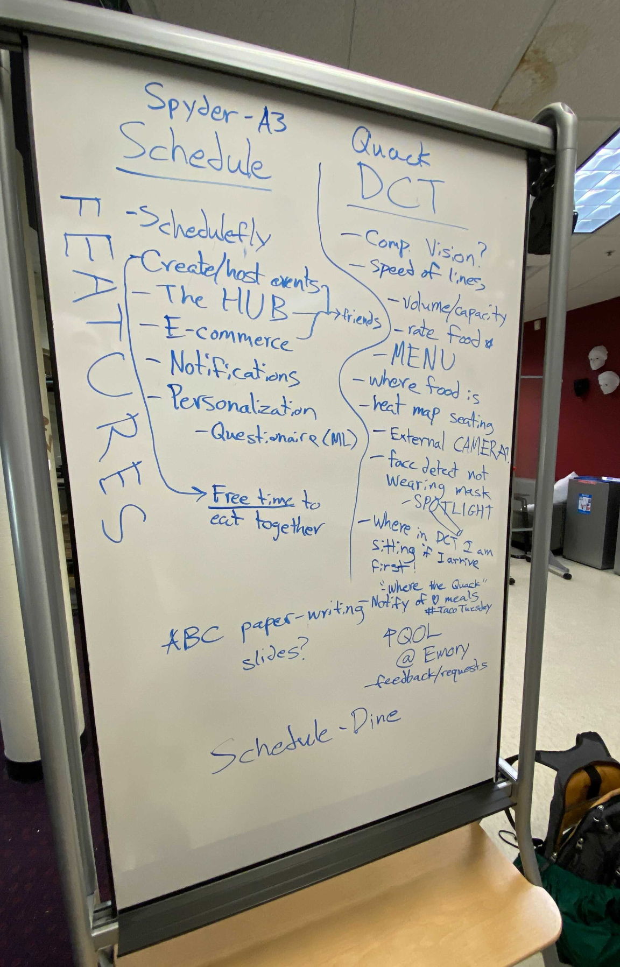
Our Features
09/17/2021
Whiteboard from Cox Tech Lab

Slide 22
THANKS
Please remember to share your feedback :)

Slide 24
TEMPLATE YOU CAN USE
Here’s what you’ll find in this Slidesgo template:
A slide structure based on a business plan, which you can easily adapt to your needs. For more info on how to edit the template, please visit Slidesgo School or read our FAQs.
An assortment of illustrations and photos that are suitable for use in the presentation can be found in the alternative resources slide.
A thanks slide, which you must keep so that proper credits for our design are given.
A resources slide, where you’ll find links to all the elements used in the template.
Instructions for use.
Final slides with:
The fonts and colors used in the template.
A selection of illustrations. You can also customize and animate them as you wish with the online editor. Visit Storyset by Freepik to find more.
More infographic resources, whose size and color can be edited.
Sets of customizable icons of the following themes: general, business, avatar, creative process, education, help & support, medical, nature, performing arts, SEO & marketing, and teamwork.
You can delete this slide when you’re done editing the presentation.

Slide 25
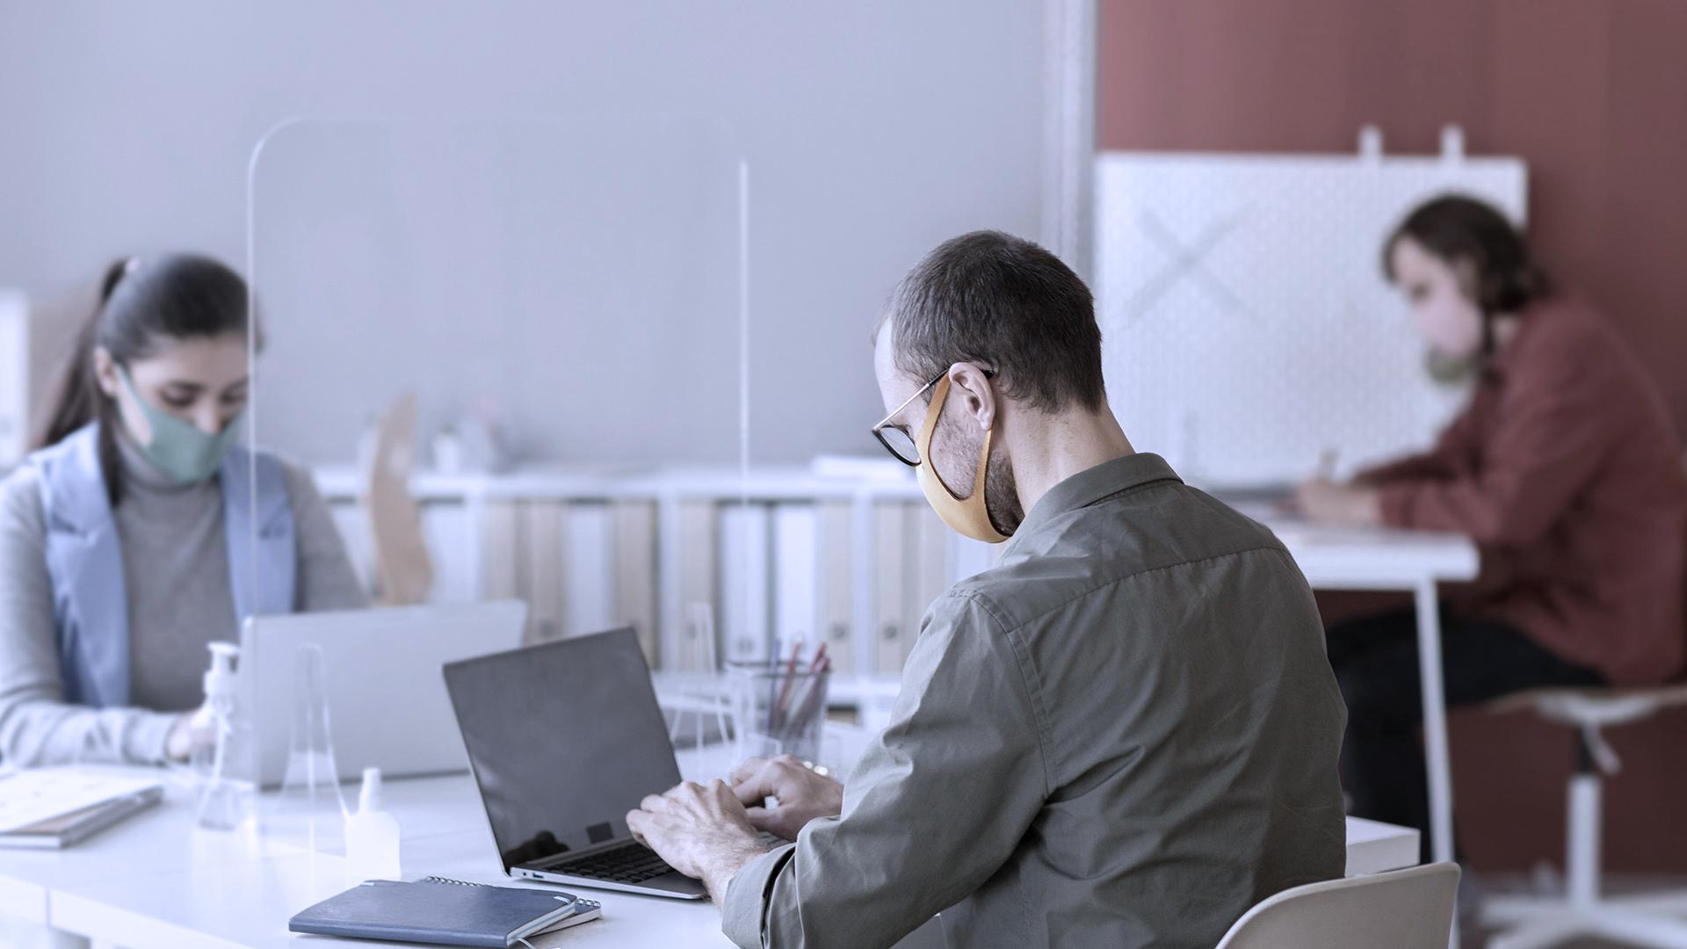
A PICTURE IS WORTH A THOUSAND WORD

Slide 26
TABLE OF CONTENTS
01
02
03
04
05
06
Business Overview
Market Analysis
Sales and Marketing Plan
Here you could describe the topic of the section
Here you could describe the topic of the section
Here you could describe the topic of the section
Management Plan
Operating Plan
Financial Plan
Here you could describe the topic of the section
Here you could describe the topic of the section
Here you could describe the topic of the section

Slide 27
REVIEWING CONCEPTS IS A GOOD IDEA
MERCURY
MARS
Mercury is the closest planet to the Sun
Despite being red, Mars is a cold place
VENUS
SATURN
Venus has a
beautiful name
Saturn is the ringed one and a gas giant
JUPITER
NEPTUNE
It’s the biggest planet in the Solar System
Neptune is the farthest planet from the Sun

Slide 28
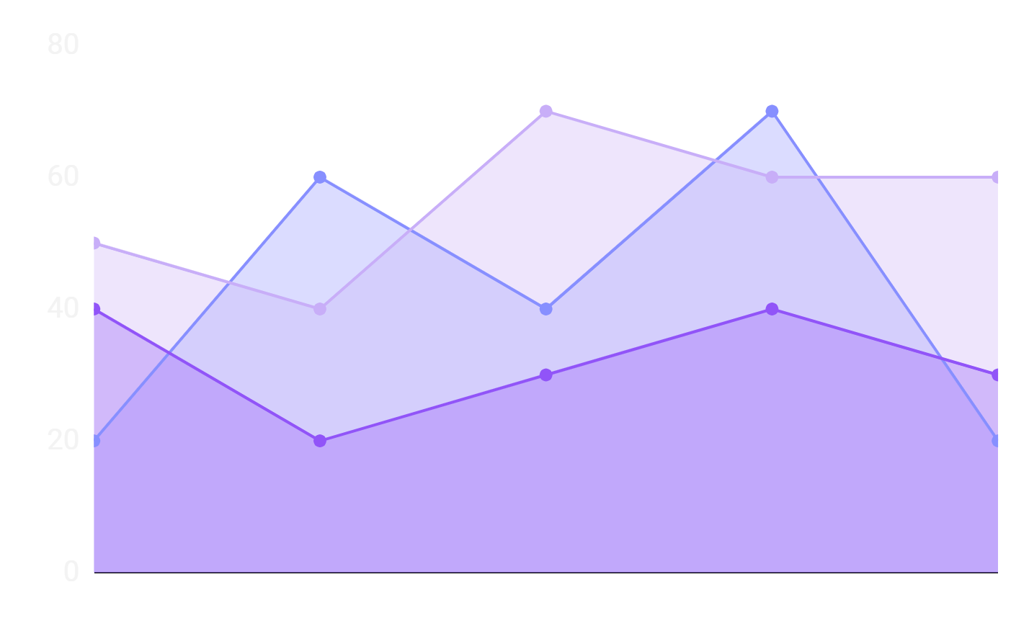
MARKET TRENDS
Despite being red, Mars is a very cold place
Venus has a beautiful name, but it’s terribly hot
Mercury is the closest planet to the Sun
To modify this graph, click on it, follow the link, change the data and paste the resulting graph here, replacing this one

Slide 29
OUR SERVICES
MERCURY
NEPTUNE
Mercury is the closest planet to the Sun and the smallest one
Neptune is the fourth-largest planet in the Solar System
SATURN
JUPITER
It is the ringed planet. It is composed of hydrogen and helium
Jupiter is a gas giant and the biggest planet in the Solar System

Slide 30
BREAK-EVEN ANALYSIS
BREAK-EVEN POINT
It's the biggest planet in the Solar System
BIG LOSS
LOSS
PROFIT
HIGH PROFIT
Mercury is the closest planet to the Sun
Despite being red, Mars is a very cold place
It's composed of hydrogen and of helium
Neptune is the farthest planet from the Sun

Slide 31
1,200,000
Big numbers catch your audience’s attention

Slide 32
COMPETITORS
MARS
JUPITER
SATURN
Mars is full of iron oxide dust, giving this planet its reddish cast
Jupiter is the biggest one and the fourth-brightest object in the sky
Saturn is a gas giant, composed mostly of hydrogen and helium

Slide 33
SALES AND DISTRIBUTION
CHANNEL 1
Mercury is the closest planet to the Sun and the smallest one
CHANNEL 2
It is the ringed planet. It is composed of hydrogen and helium
CHANNEL 3
Jupiter is a gas giant and the biggest object in the Solar System
CHANNEL 4
Despite being red, Mars is actually a very cold place

Slide 34
ADVERTISING AND PROMOTION
CHANNEL 1
ADVERTISING
It’s the farthest planet from the Sun
CHANNEL 2
PR
Venus is the second planet from the Sun
CHANNEL 3
ONLINE
It’s only a bit larger than the Moon

Slide 35
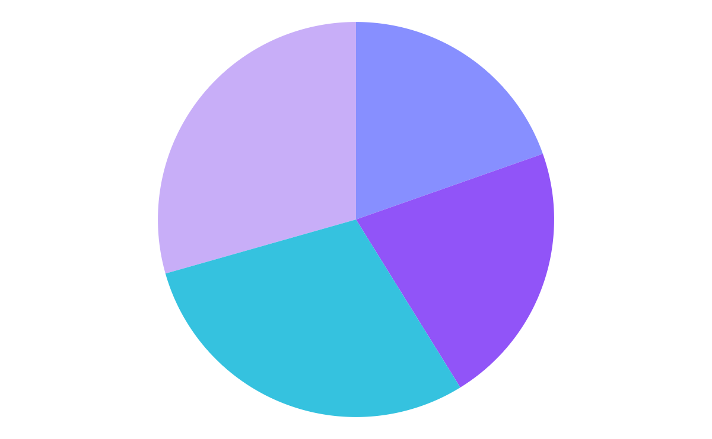
PREDICTED GROWTH
NEPTUNE
JUPITER
Neptune is the farthest planet from the Sun
It’s the biggest planet in the Solar System
MARS
MERCURY
Despite being red, Mars is a very cold place
Mercury is the closest planet to the Sun
To modify this graph, click on it, follow the link, change the data and paste the resulting graph here, replacing this one

Slide 36
BALANCE SHEET
1M
300K
700K
ASSETS
What the company owns
LIABILITIES
What the company owes
EQUITY
Difference between both

Slide 37
OUR PROCESS
DAY 2
DAY 4
DAY 1
DAY 3
DAY 5
Despite being red, Mars is actually a very cold place
Jupiter is the biggest planet in the Solar System
Venus is terribly hot, even hotter than Mercury
Mercury is the closest planet to the Sun
Neptune is the farthest planet from the Sun

Slide 38
OUR PLANS
BASIC | PRO | PREMIUM
Despite being red, Mars is a very cold place | Venus has a beautiful name, but it’s terribly hot | Mercury is the closest planet to the Sun
$50 | $75 | $95

Slide 39
THANKS
Do you have any questions?
addyouremail@freepik.com
+91 620 421 838
yourcompany.com
Please keep this slide for attribution

Slide 40
Fonts & colors used
This presentation has been made using the following fonts:
Oswald
(https://fonts.google.com/specimen/Oswald)
Roboto
(https://fonts.google.com/specimen/Roboto)
#cef3f5
#c8aef8
#878fff
#9154f8
#35c2df
#ca7beb
#972cb4
#0a1d42

Slide 41
Use our editable graphic resources...
You can easily resize these resources without losing quality. To change the color, just ungroup the resource and click on the object you want to change. Then, click on the paint bucket and select the color you want. Group the resource again when you’re done. You can also look for more infographics on Slidesgo.

